Slide 1
Bokeh
Yi Chun Chang Syeda Arzoo Irshad Runge Yan

Slide 2
What is Bokeh?
Bokeh is an interactive python library that provides elegant visualizations for large or streaming datasets on web browsers for quick and easy presentation.
The visualizations are created using Python. The Bokeh JavaScript API uses the python scripts to renders the graphs and also handles the UI interactions in the browser.
The Bokeh Server is used to synchronize between the python script and the web browser for streaming the visualizations.
Bokeh can be installed using the command – pip install bokeh

Slide 3
Why is Bokeh special?
Bokeh has several built-in tools that can interact with large datasets to render graphs that can be displayed on the web immediately.
Unlike other libraries like Seaborn, Matplotlib, and ggplot, Bokeh uses JavaScript to render the graphs which makes it more suited for building web-based application. Bokeh utilises the data structures and data analyses tools available in Python to manipulate the datasets and JavaScript translates this data into browser-friendly visualizations.
Bokeh has the capability to provide output in multiple formats such as notebook, HTML file and server.

Slide 4
Bokeh modules
As stated in the Bokeh documentation, to offer both simplicity and the powerful and flexible features needed for advanced customizations, Bokeh exposes two interface levels to users:
bokeh.models - A low-level interface that provides the most flexibility to application developers.
bokeh.plotting - A higher-level interface centered around composing visual glyphs.
Bokeh output
There are various ways to generate output for Bokeh documents. The commonly used include:
output_file – Generates simple standalone HTML documents for Bokeh visualizations
output_notebook – Displays Bokeh visualizations inline in Jupyter notebook cells

Slide 5
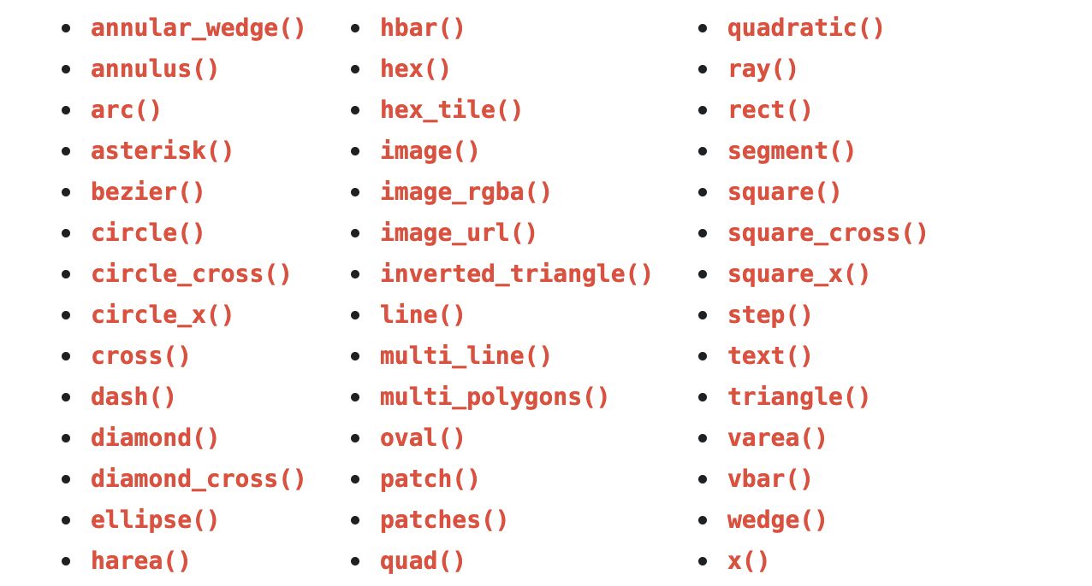
Glyphs – bokeh.plotting.Figure
Figure objects have many glyph methods that can be used to draw vectorized graphical glyphs:

Slide 6
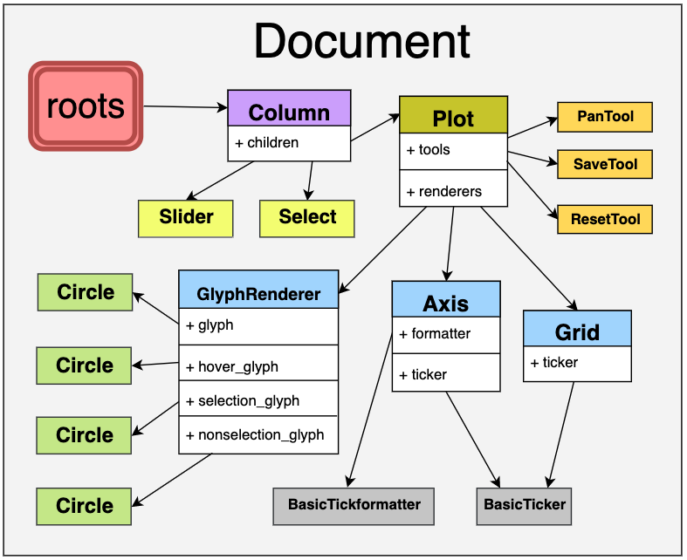
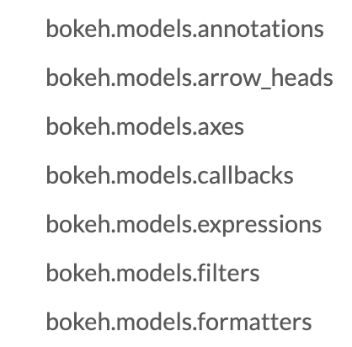
Models – bokeh.models
A Bokeh Document collects of Bokeh Models (e.g. plots, tools, glyphs, etc.) so that they can be serialized as a single collection.

Slide 7
Making Interactions
Linking Behavior
Interactive Legends
Adding Widgets
JavaScript Callbacks

Slide 8
Linking Behavior
Connected interactivity between plots -
Linked Panning: Link multi figures together for panning or zooming
Linked Brushing: Link multi points together for multi charts
Linked Properties: Link multi points together for their property

Slide 9
Interactive Legends
Glyphs manipulating (clicking or tapping on the legend entries)
Note
Interactive legend features currently work on “per-glyph” legends. Legends that are created by specifying a column to automatically group do no yet work with the feature.

Slide 10
Interactive Legends
Hiding Glyphs
Muting Glyphs

Slide 11
Adding Widgets
Button, CheckBox, DropdownMenu…

Slide 12
JavaScript Callbacks
Constraint for pure python (Ex: specialized use-cases that are outside the capabilities of the core library.)
Provide more flexible way to add custom or specialized behaviours

Slide 13
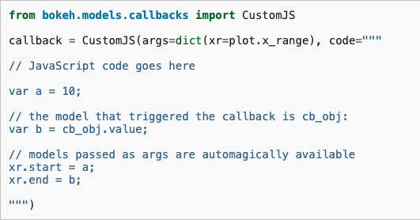
JavaScript Callbacks (Cont.)

